Slide 1
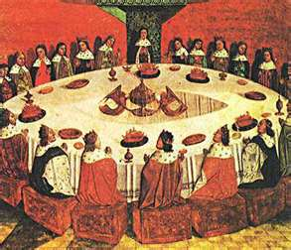
SQL SERVER Design
SASG Round TABLE WORKSHOP

Slide 2

THE BIG Picture
What is the best way to design your database?
Why this is NOT best practices
List of different objects and different design considerations
Lots of discussion

Slide 3

Why talk about it?
Bring decisions out in the open
Give people new ideas
We all share the same databases
We will talk about how your data can effect others at the end

Slide 4
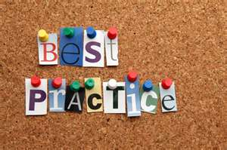
Best Practices
Microsoft Best Practices Library
Now in version 5
What does this say?
Case Studies
Don’t ask most important question of any social science research
I call it the Business Manager fallacy because they always miss it
What are the chances that this could have occurred because of random forces, i.e. chance?
Why Tom Peters is a moron…

Slide 5
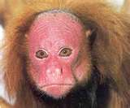
The trouble with Gimmels
Gimmels are animals on an island
When Gimmels get food, they dominate over other Gimmels who are less satisfied
Gimmels have lots of different types of foods they can eat
Some good and some wasteful
Gimmels know certain foods are good but unsure of other food stuff’s value
Is it in a Gimmel’s interest to try find new food?

Slide 6
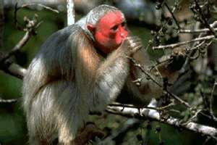
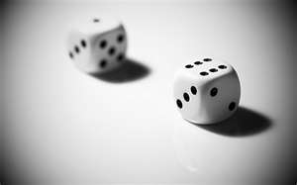
Best Gimmel Practices
If only 2 Gimmels, then it is better to stick with known strategy
Probability of better idea is small
Ability to note that other has better idea is easy to identify
As number of Gimmels grow, the strategy to stick with same ideas diminishes
Probability of better idea gets more probable
Harder to note how others have better ideas
Gimmel would be advised to try new foods in small amounts
Gimmel would be advised to note other important Gimmels

Slide 7
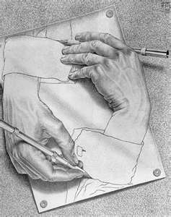
Practice vs. Design Patterns
A practice is a way to get something done
These change
Design Patterns are abstractions of how to accomplish something
They don’t change
Gimmels design patterns are get food, determine nutrition, evaluate, get more of the best food, note what other Gimmels are eating
A practice is eat celery, watch Norm the Gimmel because he is cool, see how high I can jump after eating new food

Slide 8

Google
Distributed method
Allow changes in small parts
Evolution paradigm
Test Early, Test Often
Test in small doses
Google has high level of failure but no catastrophes
Has a high level of innovation also
Game Theory- Mixed Strategy

Slide 9

Big Picture
What is the basic design that is most effective?
Base – Data in tables which are manipulated by procedures who get data from views
Why stored procedures?
Compiled Query Plan
Why Views?
Allows an interface that you can control
Example-PS Views in the OLA applications

Slide 10
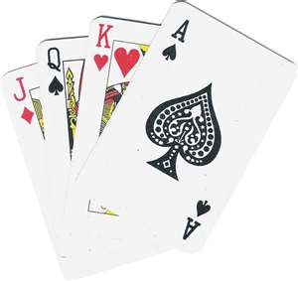
The deal
Make your tables normalized so you don’t repeat yourself
Don’t repeat yourself
Don’t repeat yourself

Slide 11
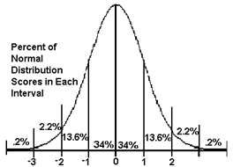
What is normal?
Normalization- E.F. Codd
Allow a “universal data sub-language” grounded in first-order logic
Codd thought SQL was flawed!
Free the database of modification anomalies
Minimize redesign when extending the database structure
Make the data model more informative to users
Avoid bias towards any particular pattern of querying

Slide 12
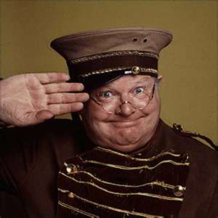
Normal in English
Use lookup tables
Use English to make easier to understand
Columns should be adjectives or states of table
Map relationships
Any other reasons?

Slide 13
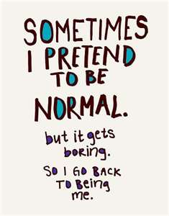
Can you be too normal?
Need to consider how the data will be queried
If you do too much manipulation, slows down the db
Don’t want to have locks
Will talk about denormalization later

Slide 14
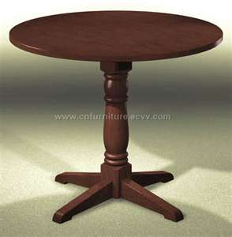
Tables
How should you name a table?
Considerations
All tables are pluralized
ERM software
_ and CamelCase and humptyDumpty
What is the best way to name tables?
Nouns and relationships
Lookups
Surrogate keys
Multiple Primary Keys

Slide 15
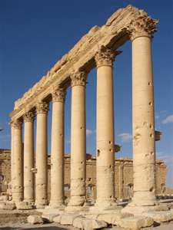
Columns
Bit, chars and ints-oh my
What are some considerations of representing lookup data?
Bit or Bit –null
Char
Int or surrogate key

Slide 16

Txtng
Char vs. Varchar vs. Nvarchar
TEXT vs Nvarchar(MAX)
String functions

Slide 17
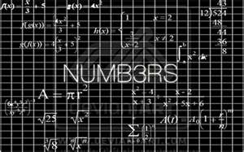
Numbers
We don’t use that much
Int
Decimals

Slide 18

It’s a date
Date vs DateTime
Formatting Dates

Slide 19

The virtue of nothing
Why make a column for data that is implied?
Calculated columns
Usually can use views or functions

Slide 20
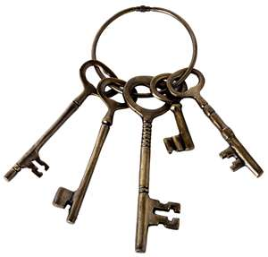
Keys to the Kingdom
Primary Keys
Foreign Key Relationships
Indexes
Relationships

Slide 21
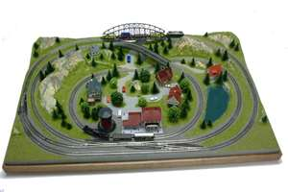
Gimmels model
What are the nouns?
Gimmels live on islands
Gimmels look for food
Gimmels have predators to avoid
Gimmels have symbiotic animals
Gimmels live in packs
What are the relationships?
What are the adjectives?
Size, Color,Name,gender
Nutrition
Deadliness
What about states?

Slide 22
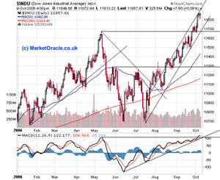
Indexes
Indexes make it faster and that is really the only point
Joins do not create indexes
Use Activity monitor to check for issues
Use SQL Query Analyser

Slide 23

Point of View
Views are best way to represent derived data
Also good to match up data between systems like PeopleSoft
Views can also show user a more understandable representation
Can extend data with unions
Hence good to code against views for selecting data
Get data from other databases!

Slide 24
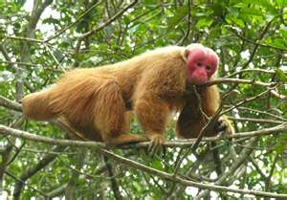
Gimmel point of view
Let’s model some views for our Gimmels

Slide 25
Let’s index the Gimmels

Slide 26
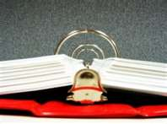
Procedures
How does sql run a query?
Makes an execution plan
Compiles it
Executes the plan
Procedures save a compiled execution plan
That is why there are best answer in most cases

Slide 27
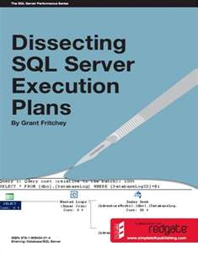
Execution plans
Index Seek
Table Scan
Index Scan
Client Statistics
Help find network issues too!
Let’s play!

Slide 28
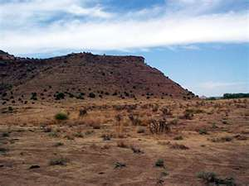
Many tables, one place
Stored procedures also allow you to multiple queries
Also allow getting and storing variables
Allow logic
Allow you to keep data pure
Can use to denormalize often used data

Slide 29
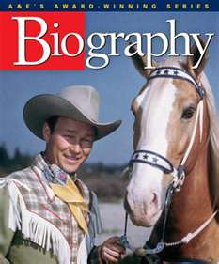
Trigger happy
Triggers can keep relational integrity
Good for audit tables
Good for denormalization
Scope_Identity vs. @@identity
Triggers vs. SPs , let’s discuss!

Slide 30
Gimmel code
Let’s do some stored procedures for Gimmels

Slide 31
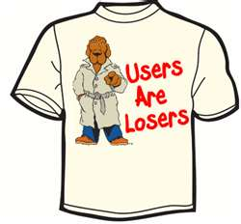
Users are losers
Our setup
Webservers –dev and prod
Assign user to datareader and datawriter
If some tables are not allowed-do deny role on that table
Assign Execute to <name>
Don’t allow servers to alter tables

Slide 32
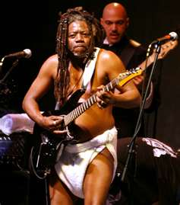
Funky functions
Table functions
Allow you to pass variable
Good when using multiple joins when some are outer
Scalar Functions
Good for text manipulation
Good for taking multiple rows and putting into one field
Allow recursion-but dangerous
Function vs. Lookup vs. Inline text change

Slide 33
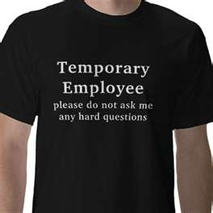
Temp tables
Don’t use them
Use table functions

Slide 34
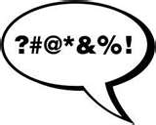
Cursors
When you are trying to do something one row at a time
Are db intensive

Slide 35
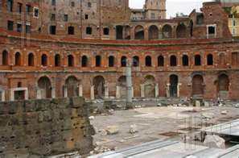
Open Forum
Any other topics we want to mention?

